Slide 1
How do CNN units achieve translation invariance?
Dean Pospisil
6/29/17

Slide 2
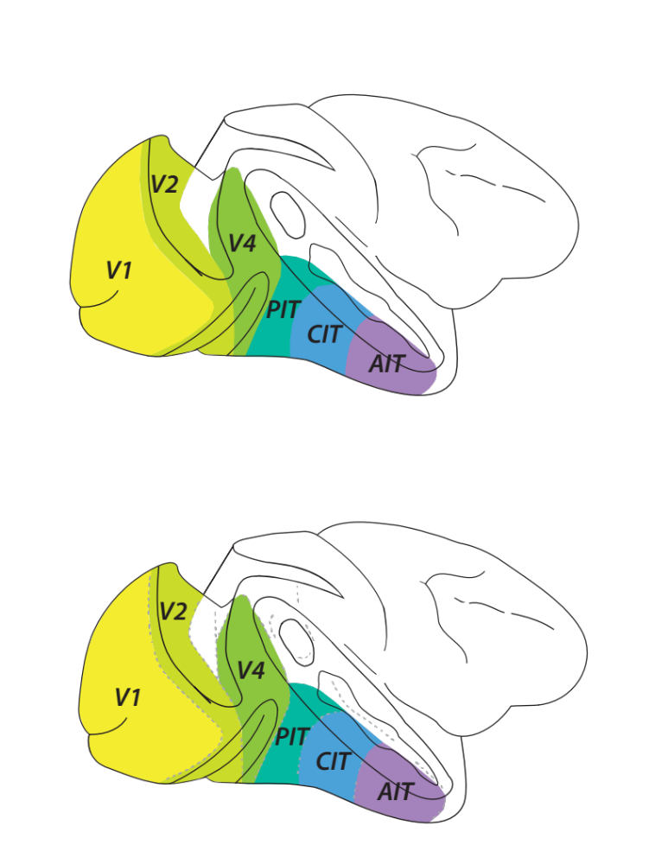
Region of Interest: V4
Notes:
I’ll be making this comparions for V4 single units and ill make it upon two criteria their tuning for the shapes of boundaries and translation invariance of unit responses.
V4 is an intermediate stage along the ventral stream, providing the bulk of feedforward input to infertemporal cortex.
Its intermediate representations are thought to support IT’s tuning for visual object categories.
Deep Convolutional Nets recently have made progress in solving this problemof object recongition and their arhcitecture is loosely inspired by the ventral stream

Slide 3
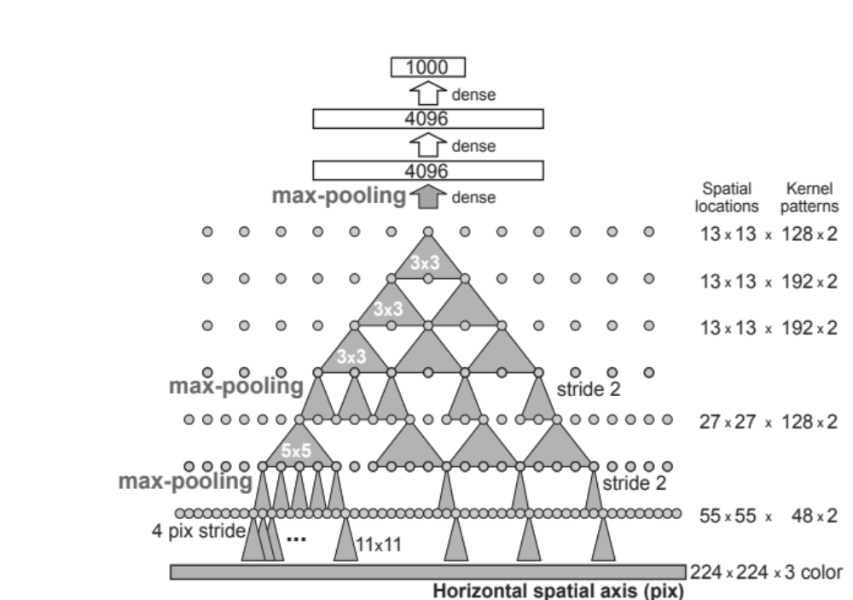
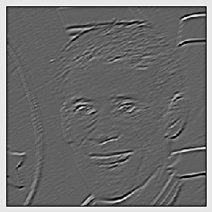
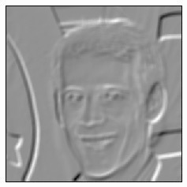
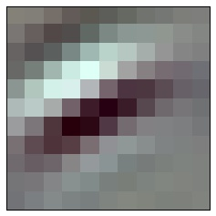

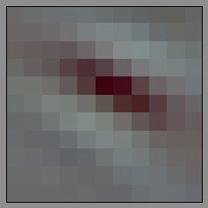
Network of Interest: AlexNet
fc 8 identification
fc 7
fc 6 fully connected
Max Pooling
128
conv 5
...
conv 4
conv 3
Conv2
48
Normalization
Max Pooling
conv 2
...
Feature Maps
Normalization
Max Pooling
48
conv 1
convolutional
...
Conv1
48
Jia, Yangqing and Shelhamer, Evan and Donahue, Jeff and Karayev, Sergey and
Long, Jonathan and Girshick, Ross and Guadarrama, Sergio and Darrell, Trevor
‘Caffe: Convolutional Architecture for Fast Feature Embedding’
Krizhevsky, Alex, Ilya Sutskever, and Geoffrey E. Hinton.
“ImageNet Classification with Deep Convolutional Neural Networks.”
Notes:
The network we will be interrogating for V4 like shape tuning is AlexNet a nice defacto standard for the study of deep object recognition networks.
This is a feedforward deep network with 8 major layers. The first five, conv1 through conv5 are convolutional, so filters weights are identical across spatial translations.
So as an example the input has some spatial extent and 3 seperate channels at each position for RGB.
So in conv1 there are 48 little filters with a depth of 3 for weights on RGB
Each of the 48 filter is run across the input image which results in 48 feature maps, which are then convolved by 128 filters in conv2 which have 48 channels operating on the 48 feature maps produced by conv1.
The last three layers are fully connected which in this context means each unit has weight on everyunit in the previous layer.
The final layer is the identification layer with a thousand units each of which represents a category, such as Great Dane, or Corn.

Slide 4
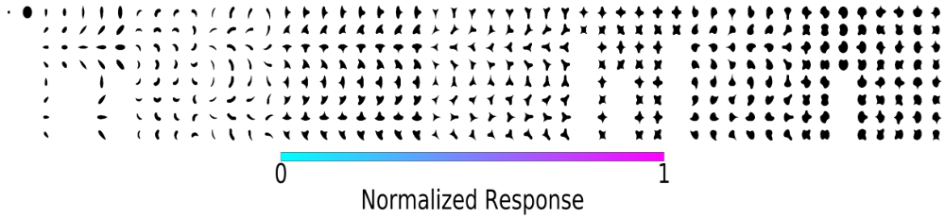
Experimental Stimuli
32 pixel diameter
Shapes
Rotations
Pasupathy A, Connor CE. Shape representation in area V4: position-specific tuning for boundary conformation. J Neurophysiol. 2001
Notes:
The images used in this experiment are a set of carefully parameterized simple shapes, 52 unique shapes at up to 8 rotations
used by Pasupathy and Conor in 2001 to measuring shape tuning in V4.

Slide 5
Translation Invariance
Receptive Field
Position 1.
Position 2
Notes:
Translation invariance is defined here as when the response of a neuron to a set of shapes, is simply linearly scaled, when those shapes are shown at different positions in the receptive field.
Translation invariance in V4 has been known for a long time, though some recent data from Yasmine El-Shamaleh and Pasupathy demonstrate it nicely.

Slide 6
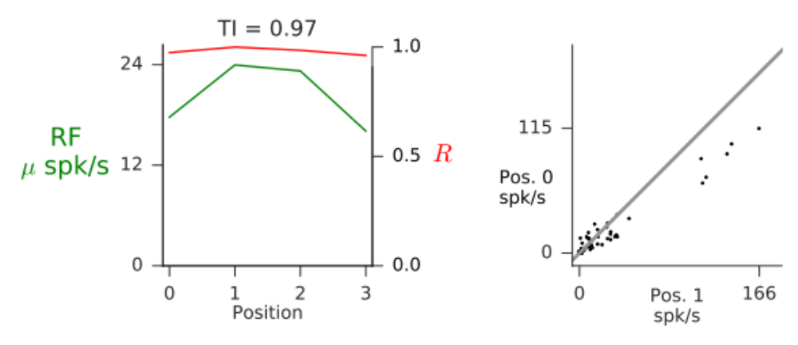
Translation Invariance
Receptive Field
Position 2.
spikes/second
Position 1.
Position 2
Position 1.
spikes/second
El-Shamayleh, Yasmine, and Anitha Pasupathy. “Contour Curvature As an Invariant Code for Objects in Visual Area V4.” The Journal of Neuroscience
Notes:
Their essential observation is that plotting responses to a set of shapes at one position has a clear linear relationship with those at another position

Slide 7
V4 Translation Invariance
-1
0
1
2
Position in RF
El-Shamayleh, Yasmine, and Anitha Pasupathy. “Contour Curvature As an Invariant Code for Objects in Visual Area V4.” The Journal of Neuroscience
Notes:
We can show translation invariance as a function of position by plotting correlation in red with respect to the responses at the center of the receptive field plotted here in green.

Slide 8
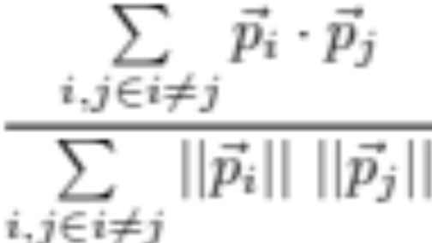
Normalized sum of covariances =
Covariance Matrix
Stimuli Position
Stimuuls ID
Sum and
Normalize [-1, 1]
Correlate
Notes:
we needed a single metric for translation invariance the one we settled on takes the response matrix, with n shapes and m positions, sums its mxm covariance matrix’s off diagnonal, then divides by the sum of the product of the response vectors length.
This is at its core just the the correlation coefficient of all unique pairs of responses.
where 1 means the response at each position was perfectly correlated, and 0 means on average they were orthogonal.

Slide 9
V4 Translation Invariance
TI =
El-Shamayleh, Yasmine, and Anitha Pasupathy. “Contour Curvature As an Invariant Code for Objects in Visual Area V4.” The Journal of Neuroscience
Notes:
Using this metric we see this this cell gets close to the upper range of the metric

Slide 10
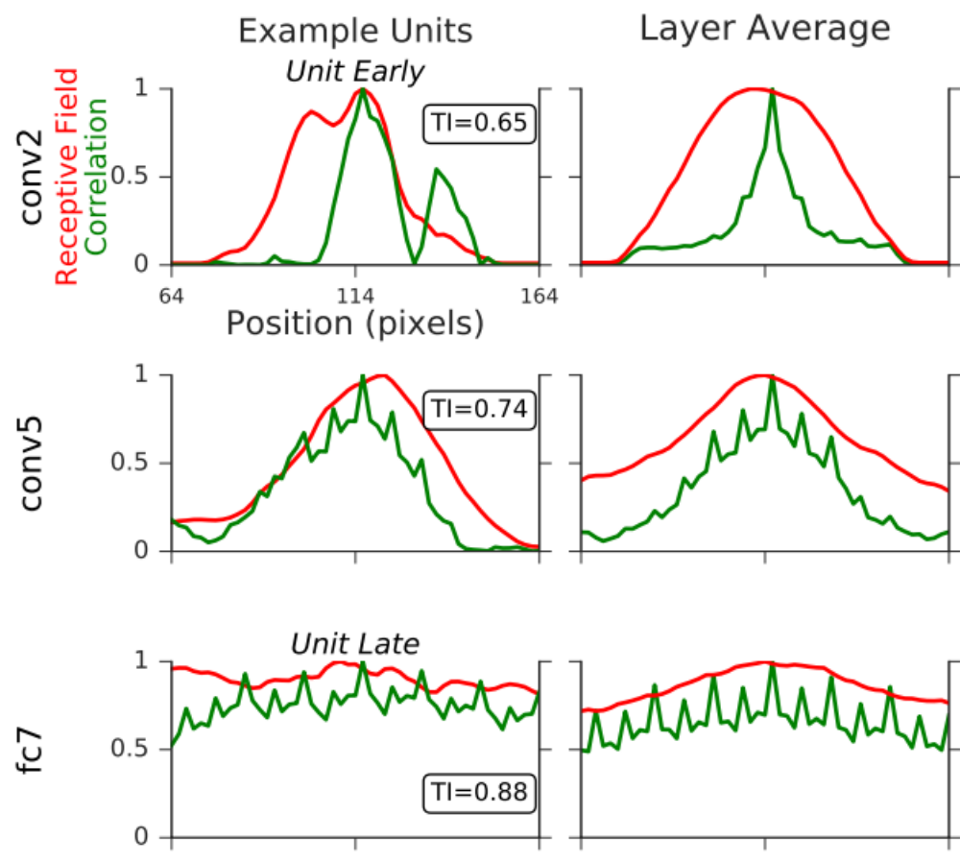
AlexNet Translation Invariance
Notes:
Here I am making the same plot for a conv2 second layer unit that had good shape tuning.
Its correlation drops off much more rapidly than response magnitude, and its TI score is quite low.
This unit would not be a good translation invariant V4 model.

Slide 11
AlexNet Translation Invariance
Notes:
Looking at an average across units in the layer, makes it clear most units are not translation invariant.
So most of those shape tuned units are not good models of V4’s translation invariance

Slide 12
AlexNet Translation Invariance
Notes:
Moving up the hiearchy we see the receptive field increases in width and TI starts to increase in an example cell and the average across a layer

Slide 13
AlexNet Translation Invariance
Notes:
Here I’ve plotted a unit in fc7 and we see even with a much wider receptive field, it still manages to keep correlation high across positions, thus it has a high TI score.
This unit because it also had shape tuning, in addtion to translation invariance, is an excellent candidate image computable model of V4 responses to boundaries.
We were very carful to ensure that all shapes and positions were within the receptive field, so this difference isn’t a result of shapes only partially overlapping the receptive field.

Slide 14
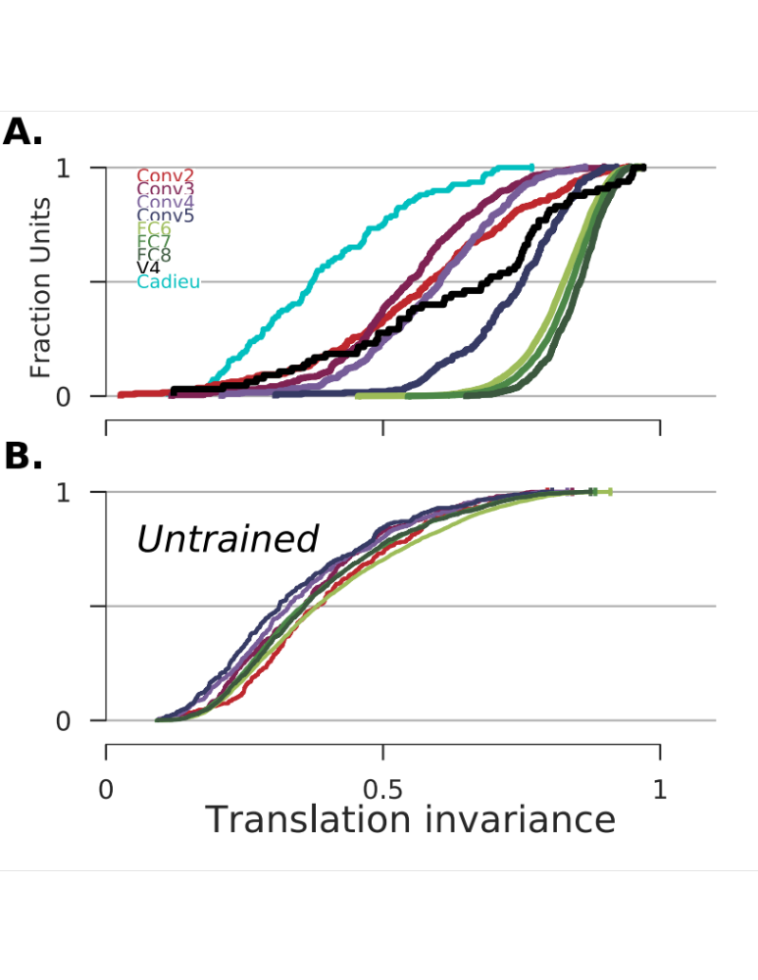
TI increases with Layer

Slide 15
Convolution and Max-pooling don’t give you translation invariance.

Slide 16
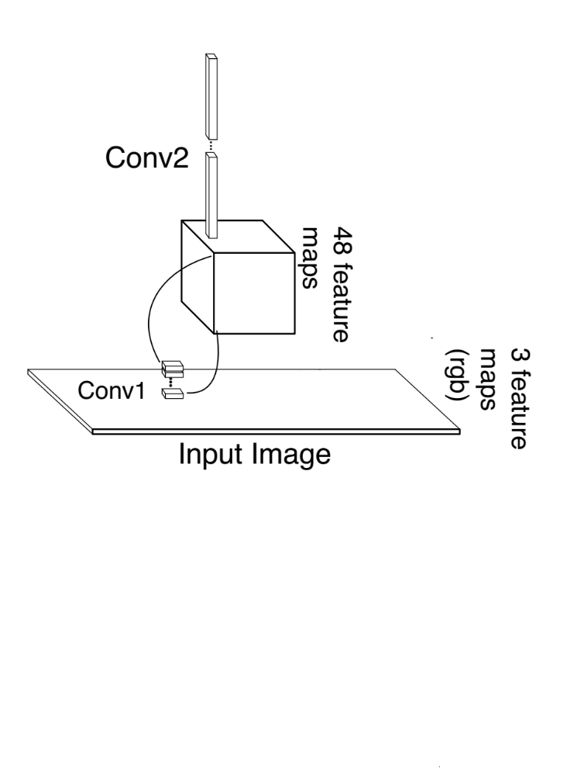
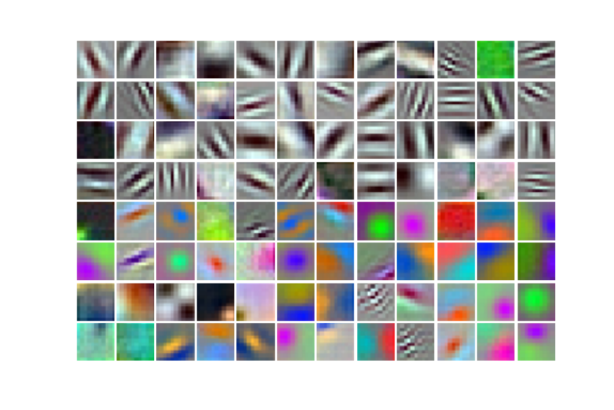
Hypothesis:
Cells with uniform spatial selectivity are translation invariant.
group 1
group 2
Notes:
Be more explicit
If you’ll recall at each convolutional stage consists of a filter with some extent in space and then weights on all incoming feature maps.
So in the first layer your have 11x11 filters with 3 channels for red green and blue.
Whereas in conv2 you have 5x5 filters with 48 channels.
We hypothesised that the more a filter tended to have similar weights across spatial channels the more translation invariant it would be
This would predict that spatial channels in some filters would all be in a very low dimensional space.

Slide 17
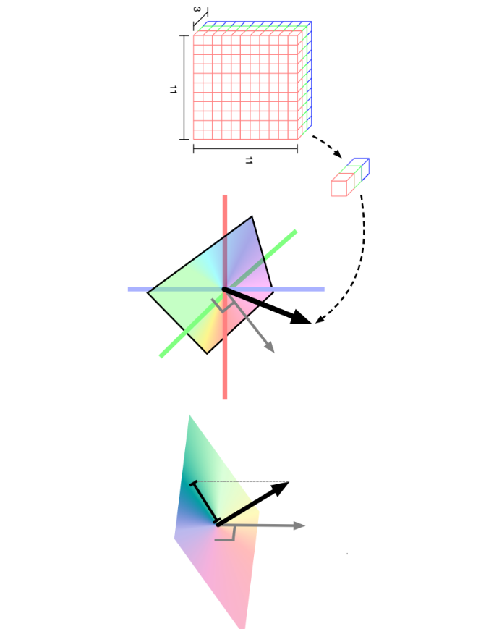


Slide 18
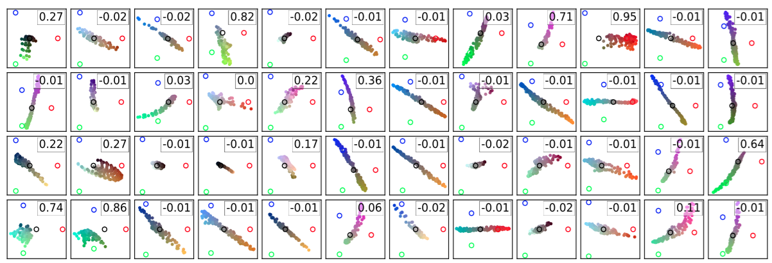
Filters plotted in the chromatic plane and their measured weight covariance.

Slide 19
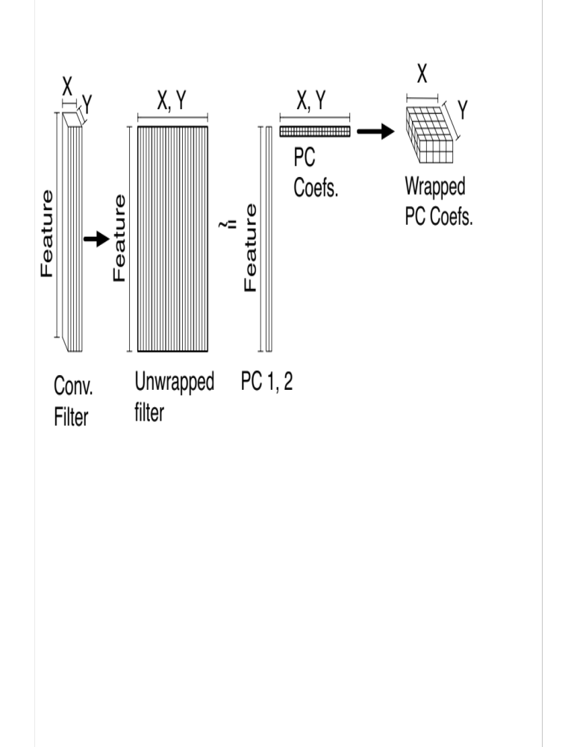
Selectivity is low-dimensional in conv2.
Notes:
We can examine this proposal by take a convolutional filter unrwapping it across its spatial dimension
then see how well we can approximate this weight matrix with two principal components.

Slide 20
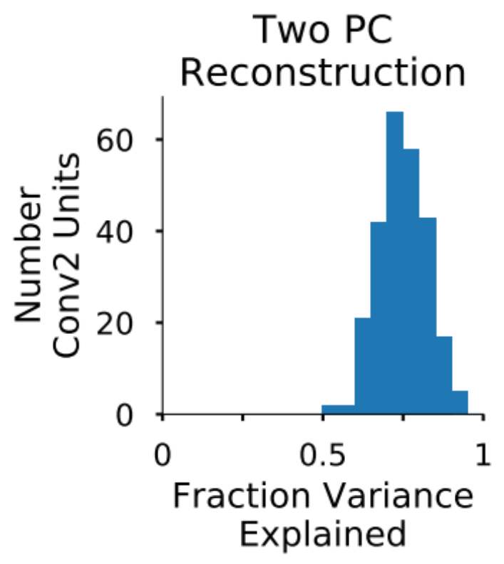
CNN selectivity is low dimensional
Notes:
If we look at fraction of variance explained we find more than half the units in Conv2 can have 75 percent of their variance explained with two PC’s.

Slide 21
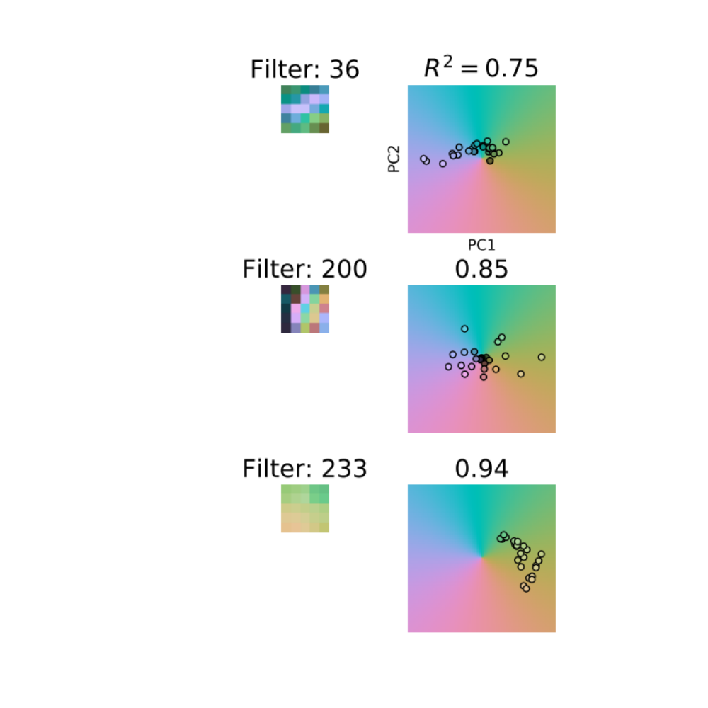
CNN selectivity is low dimensional
Conv2 Filter
Notes:
Because these conv2 filters primarily vary in two dimension we can actually examine the spatial pattern of selectivity, by wrapping their PC coefficients back up.
Mapping the PC coefficients to the hue plane, then coloring the spatial filters of an example unit accordingly makes it so similar hues reflect similar PC coefficients and thus
similar selectivity.
So we can see for the first filter it prefers one feature in a strip across its center but an anti-correlated feature in its surround, we would call this an opponent filter.
Below that we have a non-opponent cell where it is preferring positively correlated features across the receptive field.
According to our original hypothesis we would predict this to be a translation invariant unit. Because it prefers smilar features across the spatial channels.

Slide 22
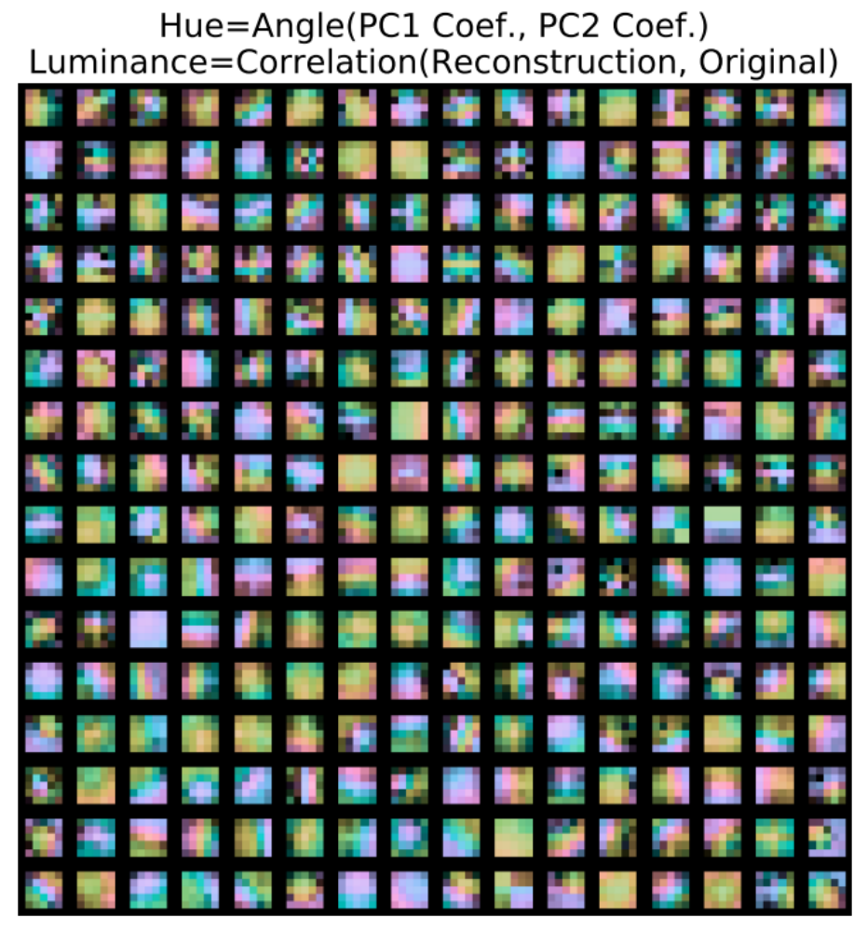
Notes:
Here we have all the conv 2 filters, and you can see there are many of these spatially smooth filters, some opponent others not. These kernels with larger smooth patches of similar hues we suspect are the TI ones.different
As a control randomize to show colors aren’t
maybe categorize by smoothness

Slide 23
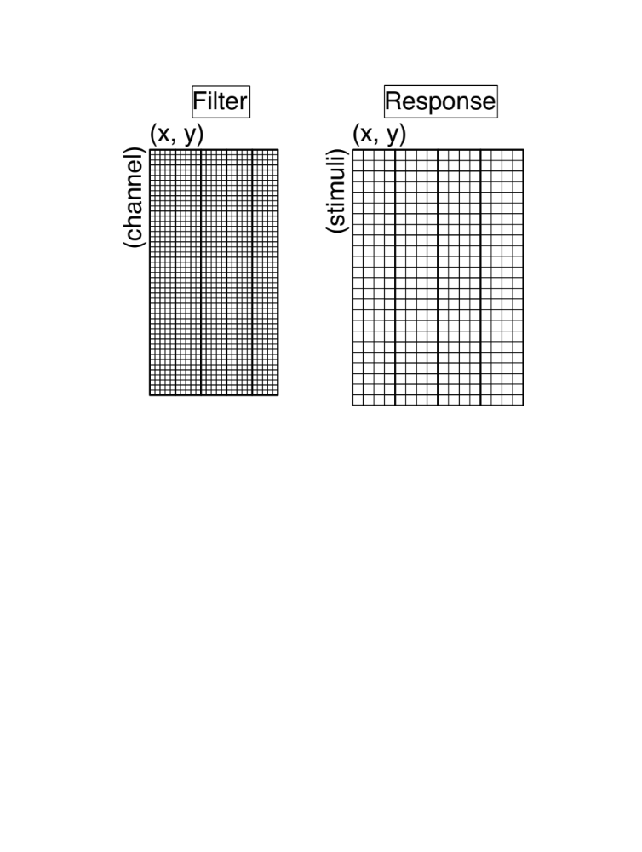
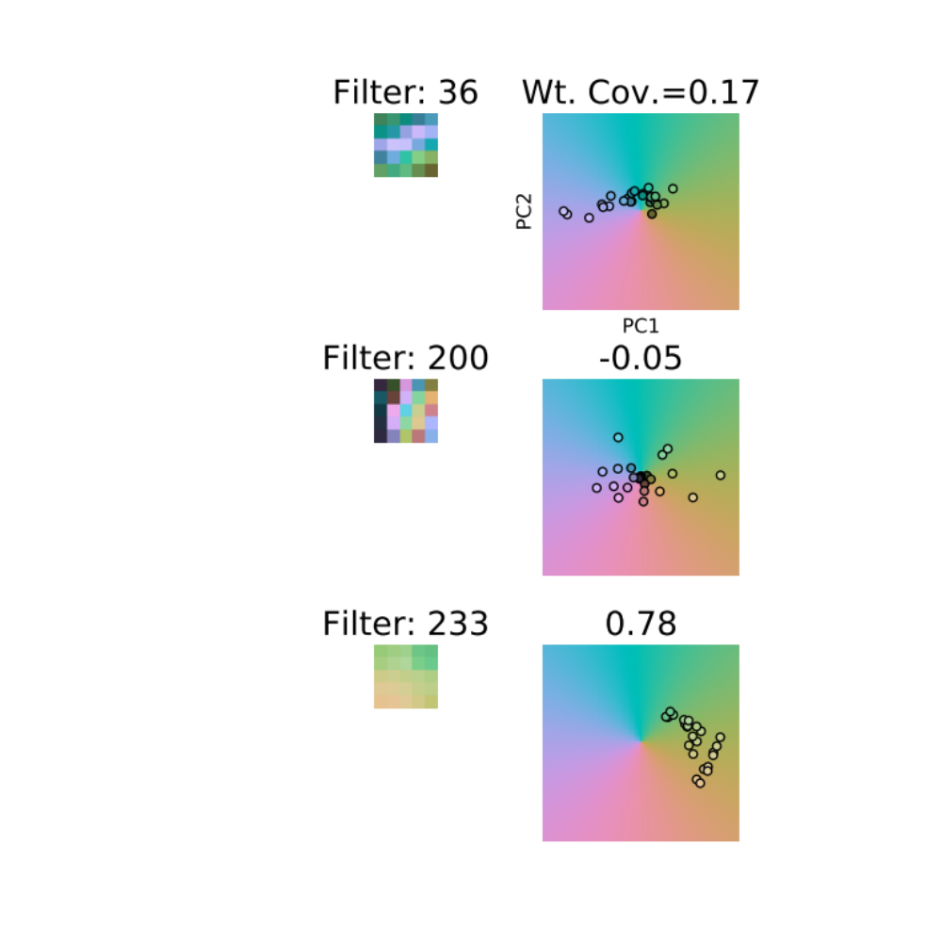
Weight Covariance
Conv2 Filter
Notes:
To measure this property we used the exact same metric as we did for TI, but instead measured the normalized covariance across filter spatial channels. So the columns of our unwrapped conv2 unit.
Here we see the metric captures that the first filter has negative covariance which cancels out its positive covariance
But the second filter gets a high score because it has many positively correlated channels and no negatively correlated ones.

Slide 24
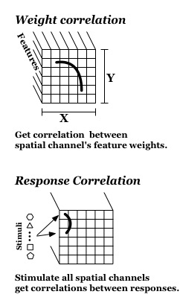
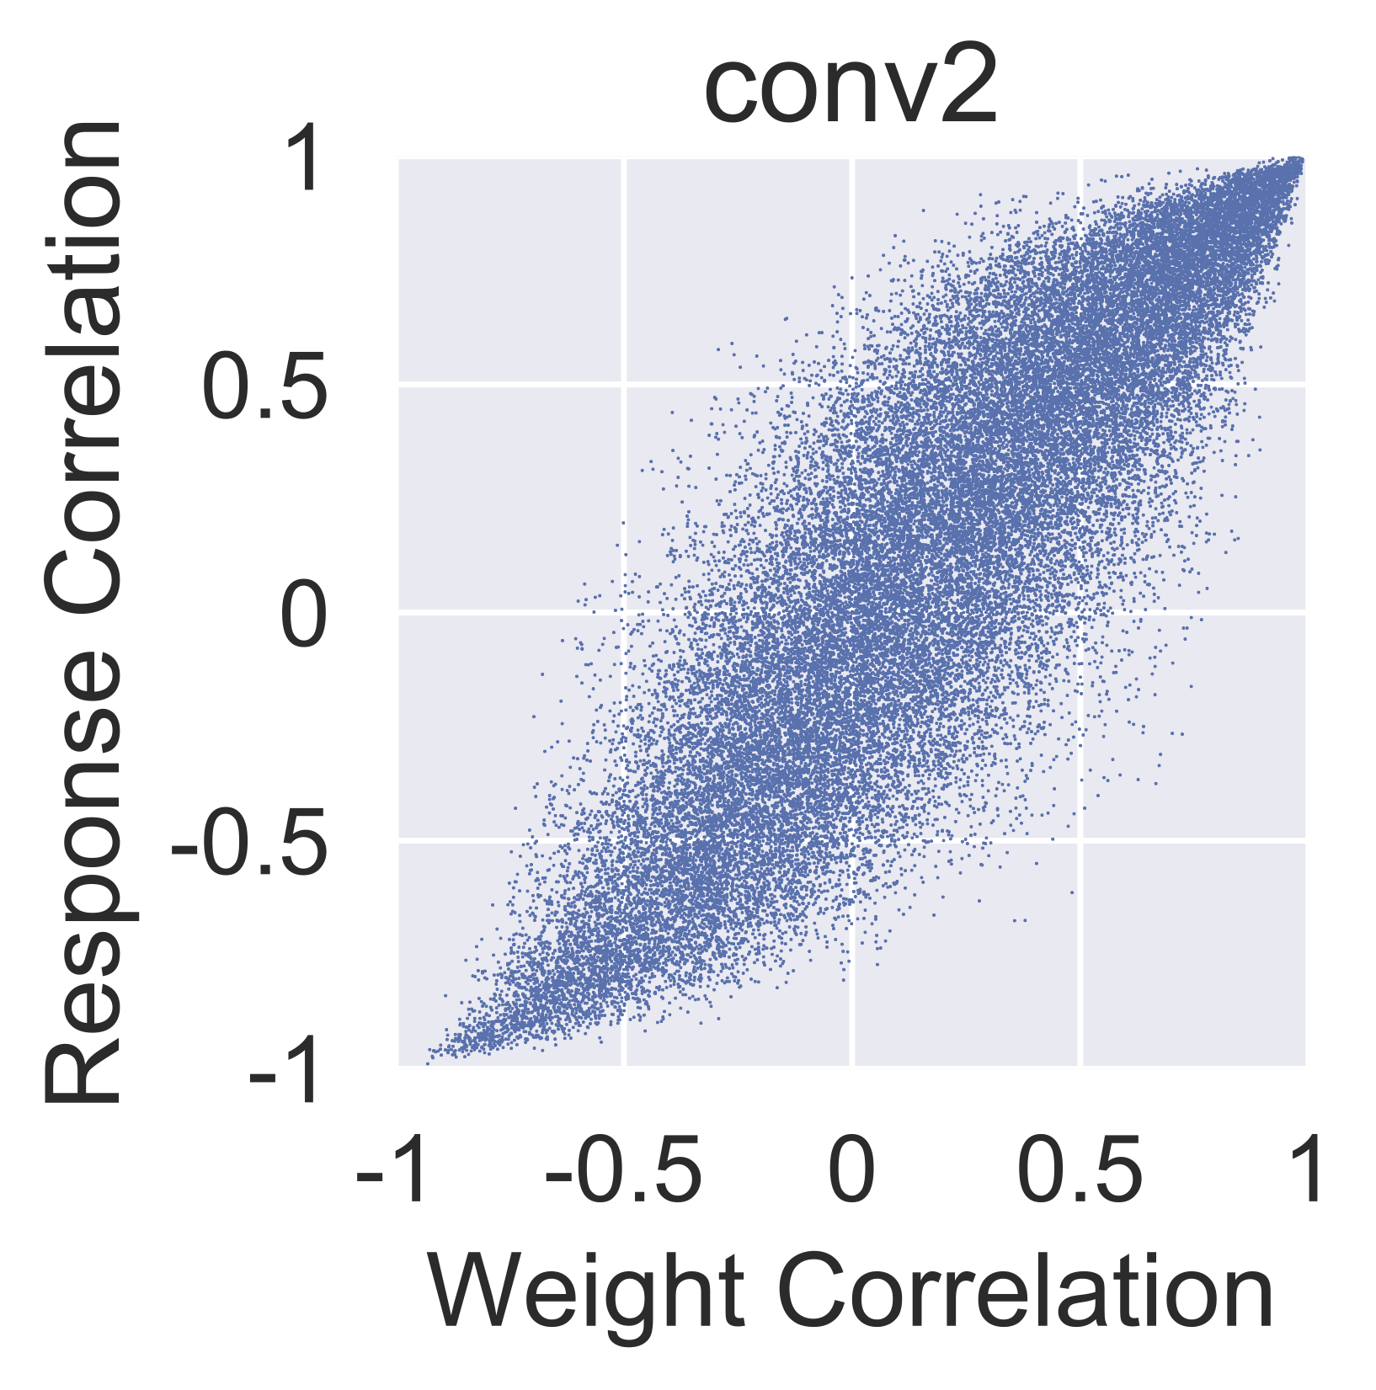
Linear models work in hidden layer.

Slide 25
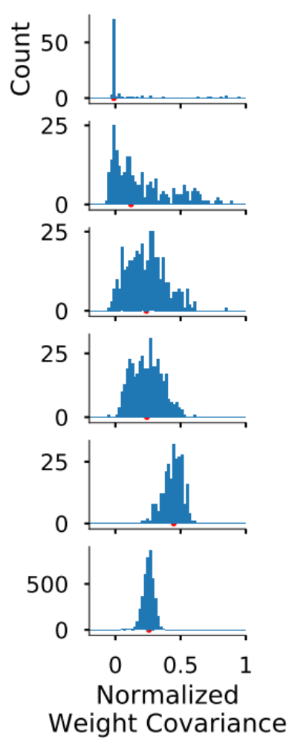
conv1
conv2
conv3
conv4
conv5
fc6
Notes:
Maybe bring in first layer filters for examples of low and high covariance.
Put the means on these plots.

Slide 26
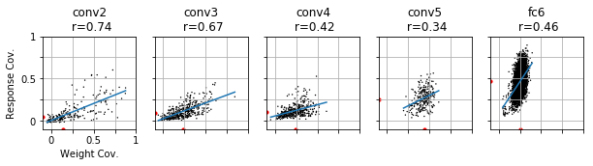
Weight Covariance Predicts TI
Notes:
When we plotted weight covariance against TI in conv2 we found a strong correlation. So the opponent cells rarely had TI, but those with high weight covariance were the only ones that could get it. Yet there is still a fair amount of variance at higher weight covariances so there must still be more factors consider.
Perhaps the smoothness of selectivity might factor in addition to whether it is weighting highly translation invariant input.

Slide 27
Weight Covariance Predicts
Translation Invariance
Notes:
run a linear regression through this show means and such
Plotting the rest of layers we see the spread maintains this triangular shape up until fc6. In conv5 the correlation drops but this is because weight covariance increases drastically here and so we only get higher TI units i.e. not this tail we see in preious layers.
Finally things change quite dramatically in FC6 where at this point each unit covers the entire image with a 6x6 filter here and even though covariance drops translation invariance increases. We suspect there must be some other factor contributing to TI here. Past fc6 there is no longer any explicit spatial dimension and so we can no longer compute the metric. Our suspicioun of why weight covariance drops relates to the fact that in conv5 in the original image its receptive fields are up to 30 pixels away from each other, whereas in fc6 it is closer to 160 pixels. At this point the network is likely interest in some spatial pattern of parts and not the homogenous repetition of the same feature.

Slide 28
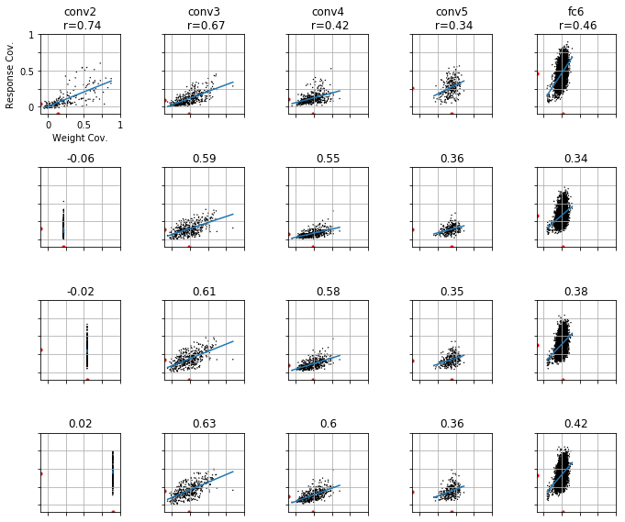
Weight Covariance Increases
Translation Invariance
1st PC
Spatial
Channel
Notes:
Plotting the rest of layers we see the spread maintains this triangular shape up until fc6. In conv5 the correlation drops but this is because weight covariance increases drastically here and so we only get higher TI units i.e. not this tail we see in preious layers.
Finally things change quite dramatically in FC6 where at this point each unit covers the entire image with a 6x6 filter here and even though covariance drops translation invariance increases. We suspect there must be some other factor contributing to TI here. Past fc6 there is no longer any explicit spatial dimension and so we can no longer compute the metric. Our suspicioun of why weight covariance drops relates to the fact that in conv5 in the original image its receptive fields are up to 30 pixels away from each other, whereas in fc6 it is closer to 160 pixels. At this point the network is likely interest in some spatial pattern of parts and not the homogenous repetition of the same feature.
Do better explanation of increase correlation

Slide 29
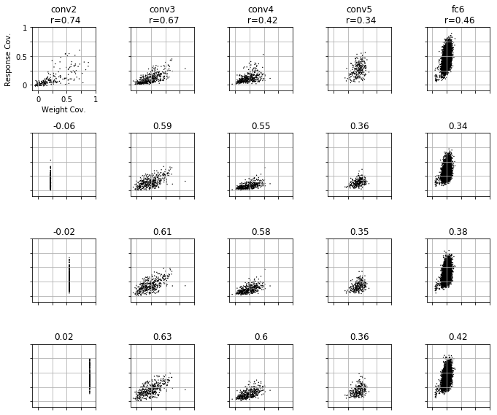
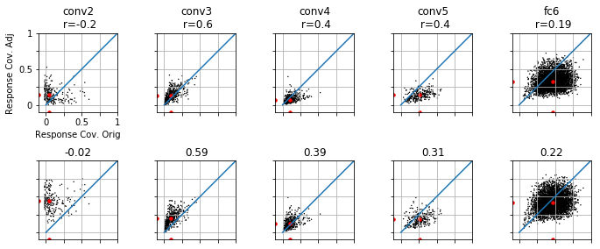
Weight Covariance Increases
Translation Invariance

Slide 30
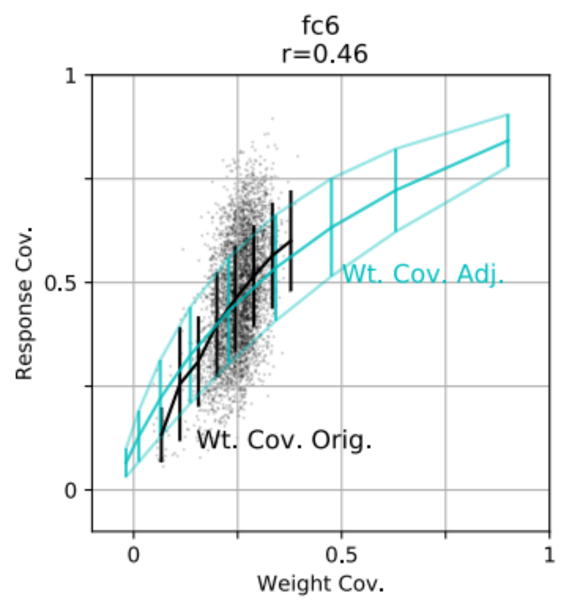
TI Could Have Been Higher

Slide 31
Thanks! Questions?

Slide 32
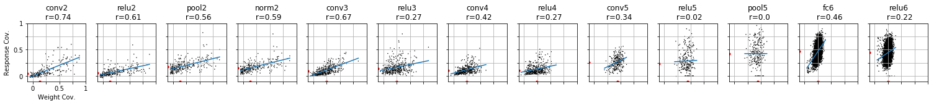
Weight Covariance Predicts
Translation Invariance
Notes:
Plotting the rest of layers we see the spread maintains this triangular shape up until fc6. In conv5 the correlation drops but this is because weight covariance increases drastically here and so we only get higher TI units i.e. not this tail we see in preious layers.
Finally things change quite dramatically in FC6 where at this point each unit covers the entire image with a 6x6 filter here and even though covariance drops translation invariance increases. We suspect there must be some other factor contributing to TI here. Past fc6 there is no longer any explicit spatial dimension and so we can no longer compute the metric. Our suspicioun of why weight covariance drops relates to the fact that in conv5 in the original image its receptive fields are up to 30 pixels away from each other, whereas in fc6 it is closer to 160 pixels. At this point the network is likely interest in some spatial pattern of parts and not the homogenous repetition of the same feature.
+ or - .5 plot mean

